Slide 1
Welcome Kit Digitally-Enabled EAP and Mental Health Program
WELCOME TO UPRISE HEALTH
2 Program Overview
3 Summary of Services
4-7 How to Access Services
8 Coaching & Short-Term Counseling
9 Digital Courses
10 More About Counseling
11 Work-Life Services
12 Online Peer Support Groups
13 Support for Managers & Supervisors
14 Monthly Newsletters
15-17 Engagement Materials & Training
GUARDIAN® and the GUARDIAN® Logo are registered service marks of The Guardian Life Insurance Company of America® and are used with express permission. The Guardian Life Insurance Company of America®, New York, NY 10004

Slide 2


PROGRAM OVERVIEW
Uprise Health offers a comprehensive suite of solutions that surround members with a full system of support. Our EAP offers resources to address issues that may be impacting a member’s mental health and their ability to be focused and productive at work and at home.
These services also act as an easy entry point into the program. In fact, members who engage in other services available within the EAP (e.g., webinars, work-life support, online peer support groups) are often more comfortable accessing counseling when they are in need.
Anytime. Anywhere support.
Coaching and
Short-Term Counseling
Financial & Legal Services
Crisis Support
Work-Life Resources
Communications & Training
Online Peer Support Groups

Slide 3

SUMMARY OF SERVICES
For the Worksite Leadership, Supervisors, and Managers
3 Coaching sessions per year
3 Short-term counseling sessions per issue
Unlimited phone consultations for supervisors or HR
Self-guided and coach-guided skill building
Access to clinical staff supported by a national network of providers
Recorded employee and supervisor orientations
Resource materials for supervisors and members
Monthly newsletters and webinars
Monthly mental health training series
Support for benefit/wellness fairs
Process development for workplace policies
Management referral packets, coaching and return-to-work planning
DOT/SAP Evaluations
Unlimited access to online topical trainings and work-life portal
Critical Incident Response (CIRs) – additional fees may apply
For Employees, Members, and Household Family Members
3 Coaching sessions per year
3 Short-term counseling sessions per issue
24/7/365 crisis support
Unlimited access to online topical trainings and work-life portal
Dependent and household member coverage
Self-guided and coach-guided and skill building
Monthly mental health training series
Online peer support groups
Emotional check-ins with AI chatbot
Get Connected
Online: worklife.uprisehealth.com
Access Code: worklife
Call: 800.386.7055

Slide 4
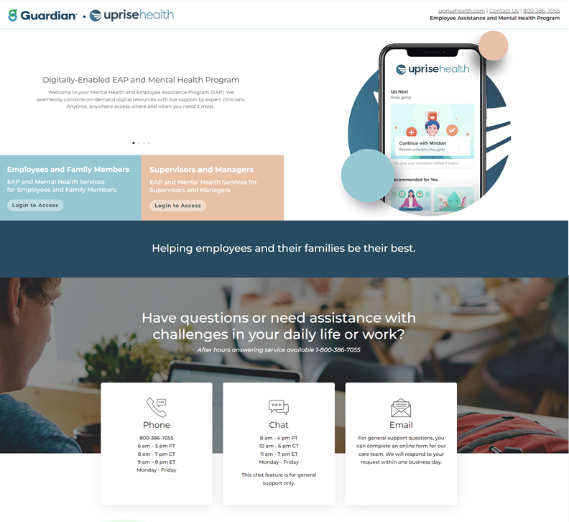
HOW TO ACCESS SERVICES
There is an access code that is used by all members to login into the member access portal. Once a member logs in, they can view the number of counseling sessions and phone number, view the online resource library, and access Work-Life services via the Personal Advantage portal.
https://worklife.uprisehealth.com/
Access code: worklife
1
2
3
1
Login for Employees and Family Members Login for Supervisors and Managers Phone, Chat, and Email
2
3

Slide 5
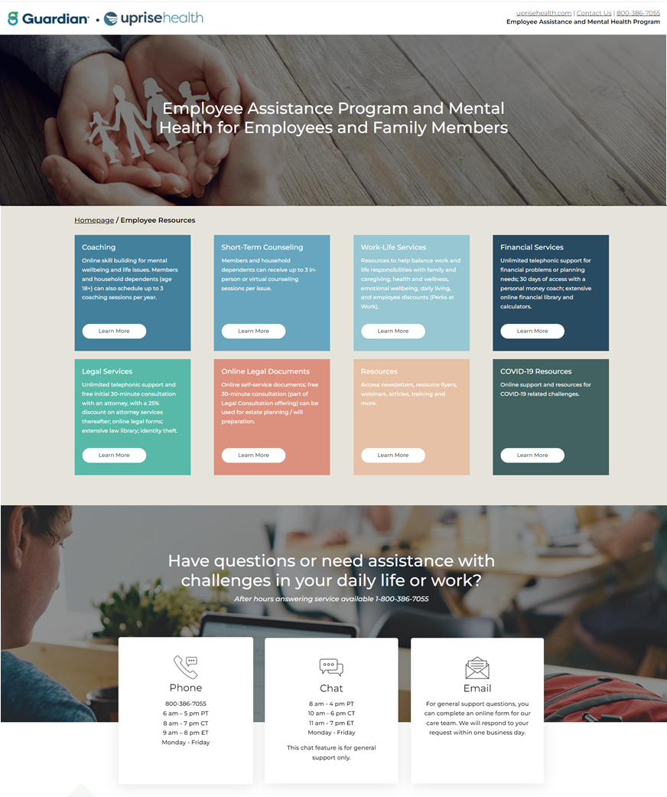
EMPLOYEES AND FAMILY MEMBERS
User-friendly access to:
Coaching
Short-Term Counseling
Work-Life Services
Financial Services
Legal Services
Legal Documents
Resources
COVID-19 Resources

Slide 6
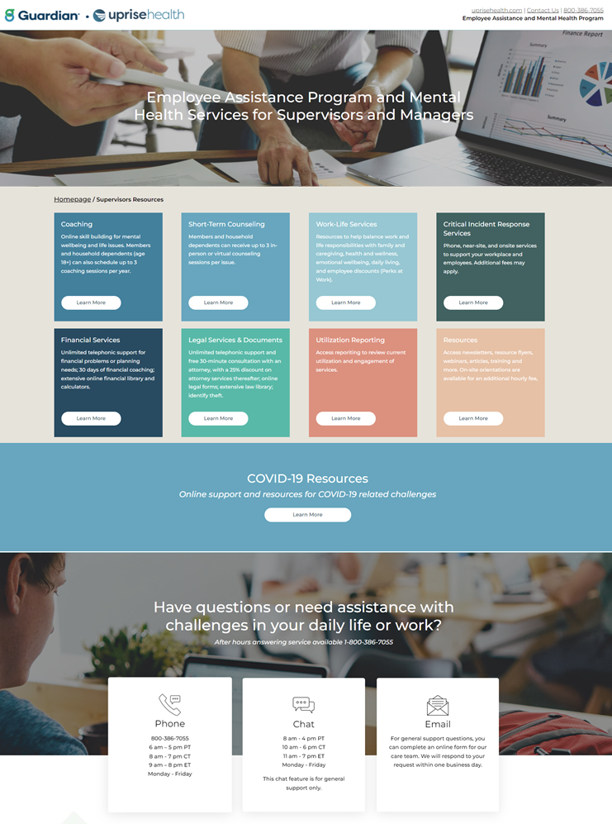
SUPERVISORS AND MANAGERS
User-friendly access to:
Coaching
Short-Term Counseling
Work-Life Services
Critical Incident Services
Financial Services
Legal Services & Documents
Legal Documents
Utilization Reporting
Resources
COVID-19 Resources

Slide 7
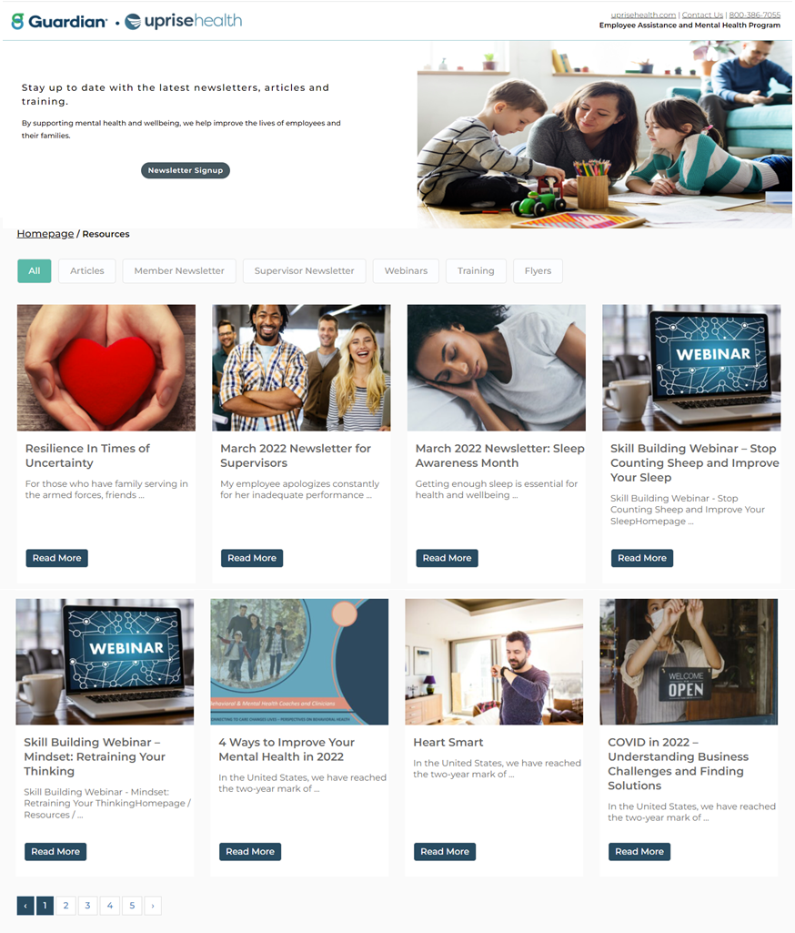
ONLINE RESOURCE LIBRARY
As part of your current program with Uprise Health, all members and family household members have an extensive online resource library. User-friendly design, filters, and search features provide easy access to find the latest newsletters, mental health and work-life flyers, training, and leadership support materials.

Slide 8

COACHING AND SHORT-TERM COUNSELING
For a deep level of support, members can self-select and schedule an appointment with a coach or EAP provider. Our coaches and nationwide provider network of more than 60,000 counselors can be filtered by criteria including geography, clinical specialty, cultural background, and other preferences, to ensure a perfect fit for each member.
Coaching Services – 3 Sessions
Focused on teaching a skill and how to apply it to a stressful situation (e.g., mindfulness, reframing unhelpful thoughts, etc.)
Goal is to build and improve stress management skills
Provided by licensed, master’s-level clinicians or above located within the U.S.
Available via 30-minute phone and video sessions
Short-Term Counseling Services – 3 Sessions per Issue
Focused on using evidence-based protocols to address mental health issues (e.g., anxiety, depression, etc.) identified through a comprehensive clinical assessment
Goal is to reduce mental health symptoms
Provided by local licensed and credentialed providers our network
Available via 50- to 60-minute face-to-face, phone and video sessions

Slide 9
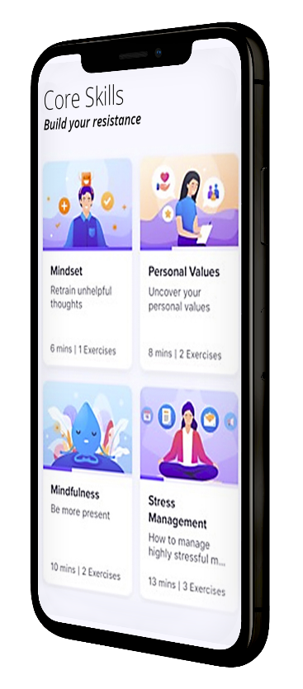

DIGITAL COURSES
Uprise Health also offers a library of more than 40 curated, CBT-based courses, providing on-demand support and enabling users to build skills for goal setting, addressing challenges, and developing resiliency.
Our digital courses cover a wide variety of mental health topics, including:
Alcohol and addictions
Cognitive re-training
COVID-19 anxiety
Financial mindset
Insomnia and sleep management
Leadership
Management training
Metacognition and core beliefs
Mindfulness
Pain and fatigue
Productivity
Reflective listening
Stress and anxiety management
Wellbeing
These courses are available 24 hours a day to all employees, regardless of risk level or engagement in other Uprise Health services. Members identified as low-risk can access courses to self-manage their mental health and wellbeing, while coaches and EAP providers use these courses to supplement and augment their treatment of members with an increased risk profile.

Slide 10
MORE ABOUT COUNSELING
Requesting Counseling by Phone
Calling Uprise Health usually takes less than five minutes.
The Uprise Care team will ask for some basic information including employer name, member name, call back number, and needs and preferences.
If a member calls in crisis, they will be connected with a clinician during the call for immediate help.
Scheduling a Counseling Appointment
Uprise Health will provide a list of available counselors that best match the needs and preferences of the member.
Members can call to schedule their own appointment, or the Uprise Health care team can assist with scheduling.
Calling for Crisis Support
During business hours, members who are in crisis will be connected with an Uprise Health clinician who will stabilize the situation and refer to appropriate support.
After hours answering services are available and calls can be triaged to licensed professionals for emergent or crisis calls.
Members that are in life threatening situations should immedicably call 911 as they would do with any other medical/life emergency.

Slide 11




WORK-LIFE SERVICES
In addition to robust clinical services, Uprise Health offers a comprehensive suite of solutions that surround members with a full system of support. Our EAP offers resources to address issues that may be impacting a member’s mental health and their ability to be focused and productive at work and at home.
These services also act as an easy entry point into the program. In fact, members who engage in other services available within the EAP (e.g., webinars, work-life support, online peer support groups, etc.) are often more comfortable accessing mental health support when they are in need.
Child and Elder Care
Parenting support
Resources for caregivers
Assistance for elder and childcare services
Legal Services
30-minute consultation with a network attorney and a 25% discount for retained services
Personal mediation services
Legal forms library
Financial Services
Free 30 days of money coaching with a personal Money Coach
Budgeting tools and financial calculators
Online Resources
Online Library of more than 20,000 articles and resources
Easy-to-use platform with resources to help members with the essentials of daily life

Slide 12
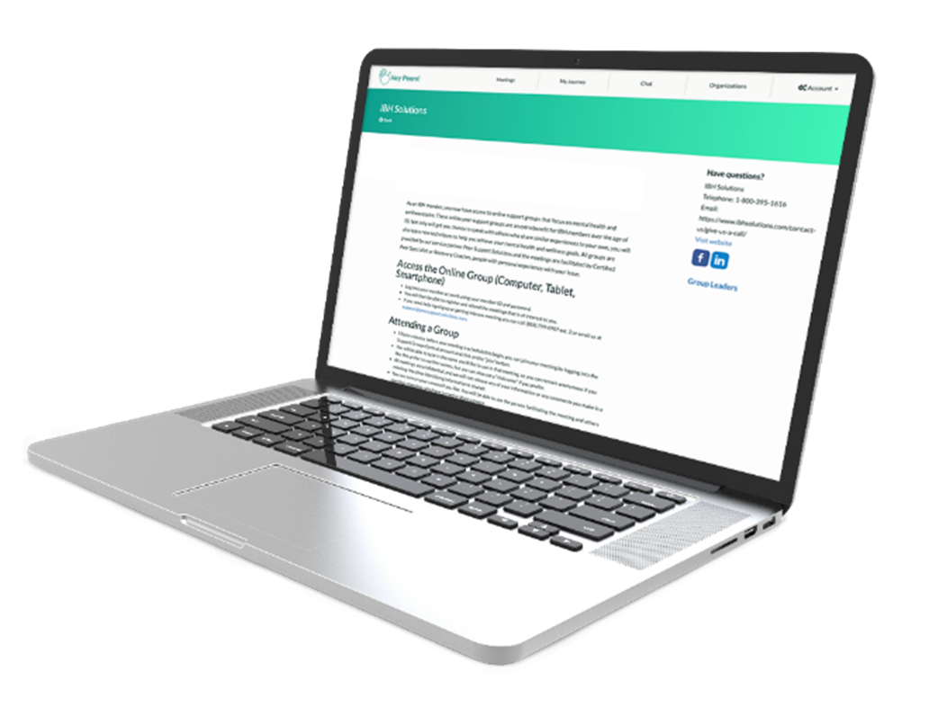
ONLINE PEER SUPPORT GROUPS
Employees can join up to 10 online support groups with others who have similar issues to share ideas, support, and encouragement. We offering a wide variety of groups that are confidential and are led by certified peer specialists or recovery coaches.
Addiction Recovery
Anxiety
Depression
Front Line Employees/First Responders
Grief and Loss
Parenting

Slide 13
SUPPORT FOR MANAGERS & SUPERVISORS
Critical Incident Response Services
Uprise Health offers expert consultation and prompt on-site services to address employee needs, stabilize traumatic situations, and mobilize additional supports and services. We also provide dedicated specialists to coordinate all critical incident response services and offer the nation’s largest network of critical incident response providers. Please call Health 800-386-7055
Management Consultations and Referrals
We also provide practical guidance for uncomfortable situations, helping supervisors to identify and respond to declining work performance or behavioral issues. Our consultation services equip managers to address employee performance issues and ensure a safe and productive workforce. Meanwhile, our formal referral services give struggling employees the tools they need to cope with their adversities and help get them back on track in the workplace. Please call Uprise Health 800-386-1616 for additional information.
Notes:
Expand pages for consultants, mandatory referrals….

Slide 14



MONTHLY NEWSLETTERS
Newsletters are emailed the 1st day of each month and past issues are available on resource page. Sign up for newsletters: https://worklife.uprisehealth.com/newsletter-signup/

Slide 15
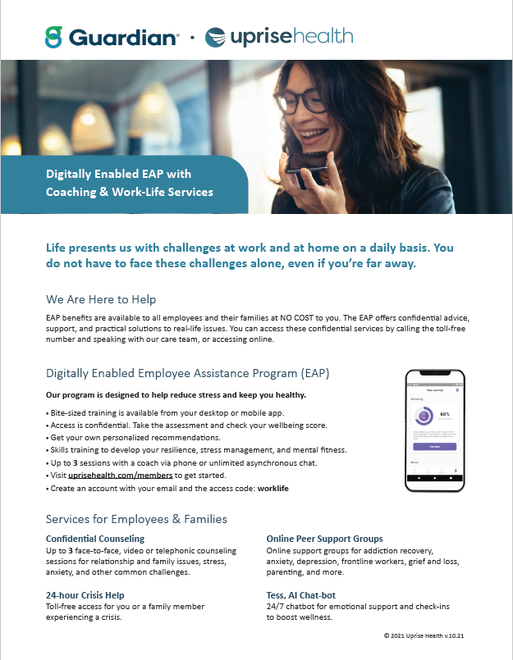

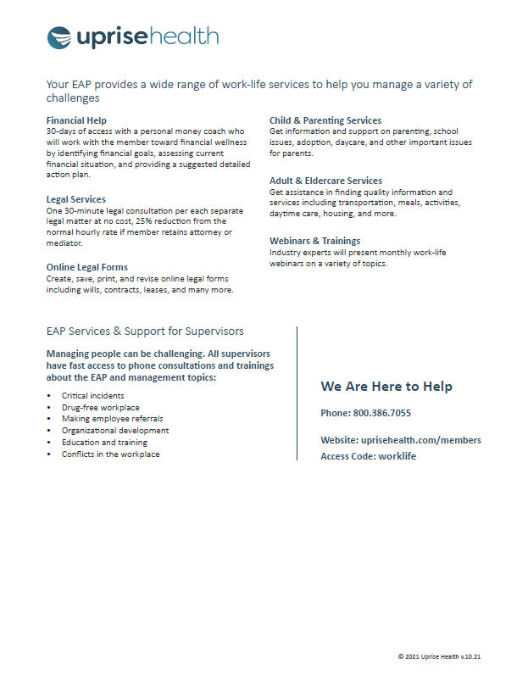


ENGAGEMENT MATERIALS
Member support flyers are available on the Resources page.

Slide 16
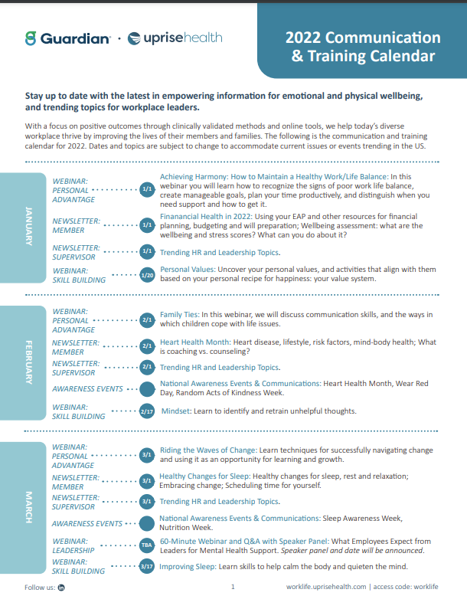
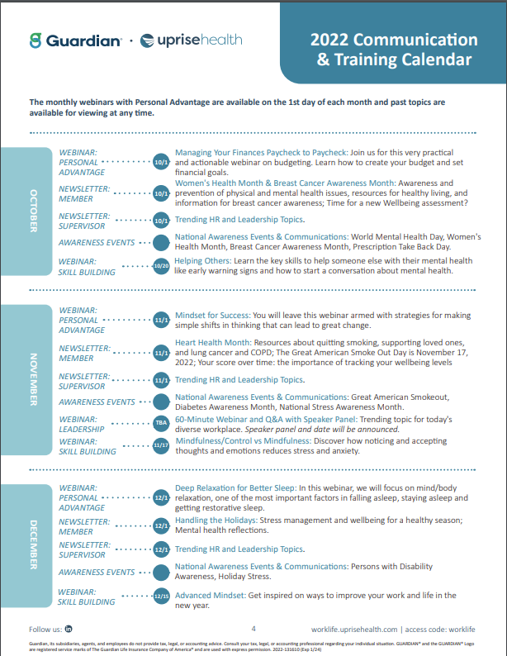
TRAINING AND COMMUNICATIONS
Uprise Health recognizes that our customers have a wide range of employees, and members may interact with their healthcare in a wide range of ways. We have developed numerous supervisor and employee trainings and communications to proactively engage members to utilize the work-life services. We remain committed to working with you to ensure the success of effective communications and training programs. A copy of the current calendar is available in the resource library.
Our promotional strategies and communication campaigns include:
Targeted campaigns/promotions during stress-inducing times of the year (e.g., holidays, workplace transitions, natural disasters, etc.).
Monthly newsletters for supervisors and members (available in English and Spanish).
Monthly webinars through Personal Advantage that cover a wide range of topics.
Monthly mental health skill building webinars.
Communications, which can be sent to any email address provided to Uprise Health.

Slide 17

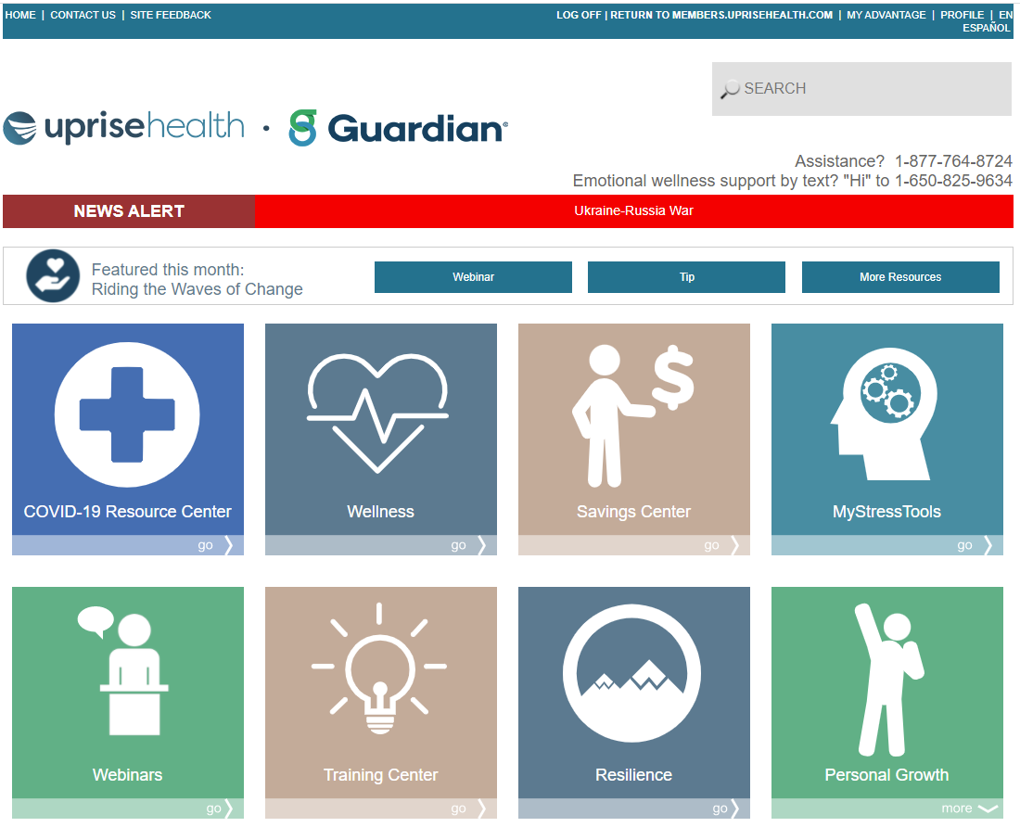
WEBINARS
The monthly on-demand webinars with Personal Advantage are available on the 1st day of each month and past topics are available for viewing at any time on under Work-Life Services.
The webinar topics are provided in the communications calendar at the end of this document.

