Slide 1

Employee Assistance and Mental Health Program
Employee Orientation

Slide 2




Overview
Engage
We all face challenges - - and every employee is different.
Sometimes just a phone call or access to resources are needed
Other times, coaching or counseling services are a better solution
We connect you with the level of care you need
Services are available to employees and dependents
Round the clock, confidential access
Member
Assist
Assess
Notes:
IBH services are available to all employees and their family members, whether or not they are covered by the health plan. In fact, we believe strongly in the importance of mental health support, and we do not deny services when someone contacts IBH for help.
You and your employees will benefit from the following IBH differentiators:
• Our tailored and high-quality behavioral health solutions are built on a robust, clinically-driven platform—providing multi-modal, on-demand access to care via face-to-face, phone, video, and synchronous and asynchronous chat.
• Through our fully-integrated platform, members will have access to highly engaging, self-guided cognitive behavioral therapy (CBT) programs recommended based on an initial clinical assessment and their identified needs.
• Highly effective health coaching is provided by expertly trained clinicians, who tailor sessions to each participant’s stated goals, level of readiness to change, and social determinants of health.
• Our best-in-class network, which includes more than 60,000 providers located across the U.S., offers easy access to the broadest range of top-quality counselors, all of whom meet our strict credentialing standards.
• We offer broad and on-demand analytics to measure engagement and program outcomes, which will enable Gallagher to assess the effectiveness of the program and be agile in its response to mental health trends among its employees.

Slide 3

Welcome To Your EAP
Coaching
Counseling
Work Life Resources

Slide 4
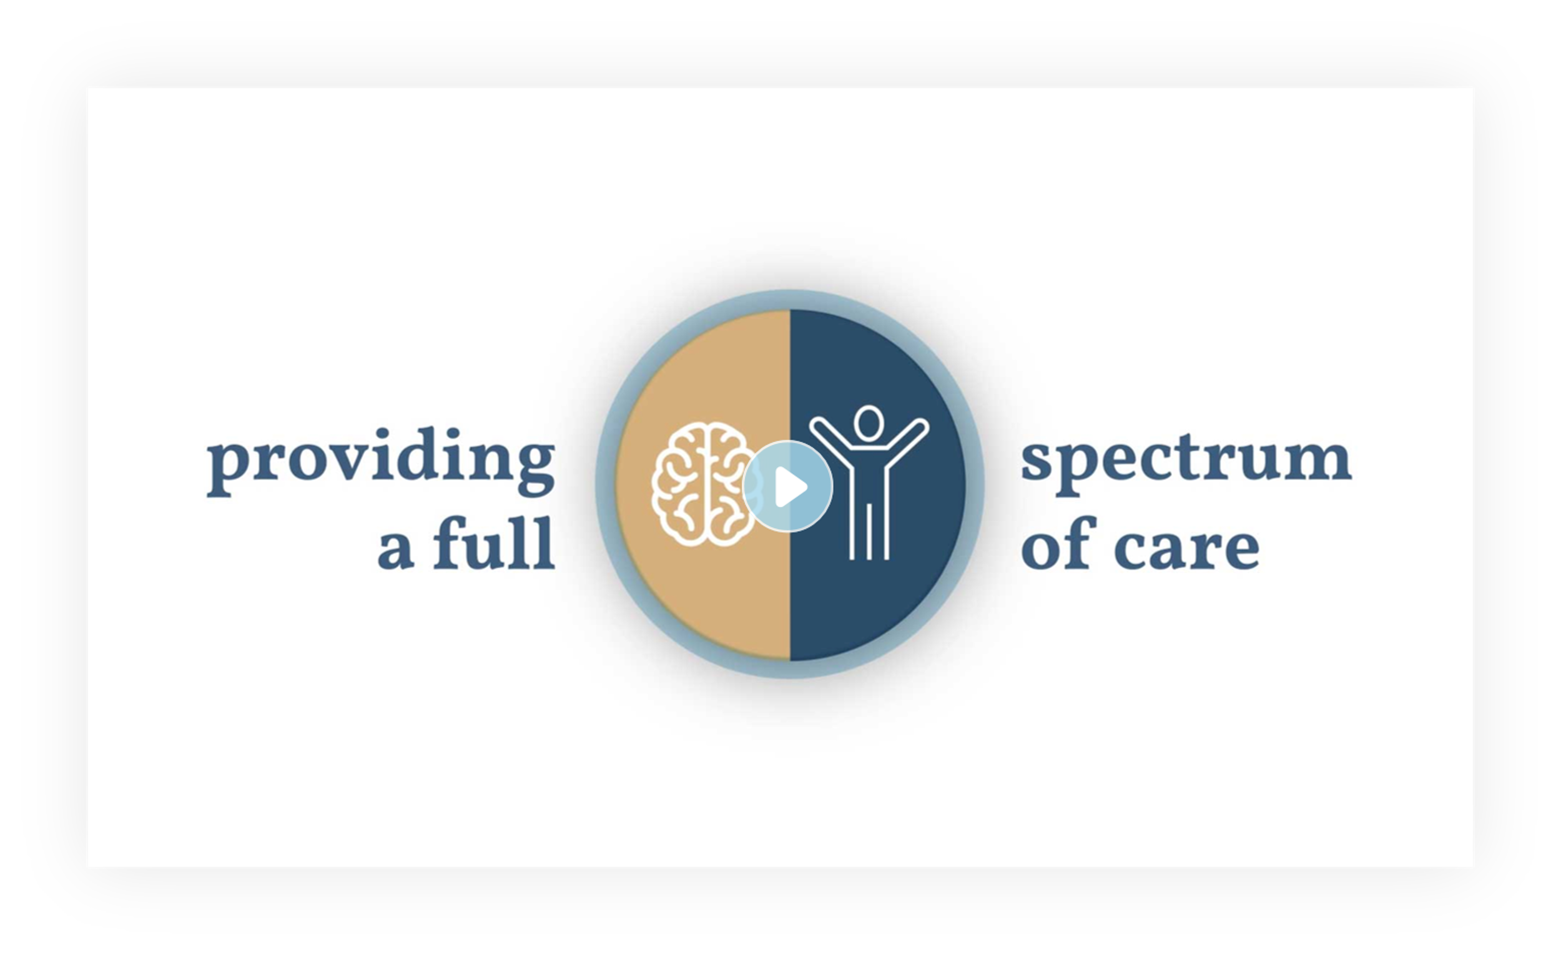
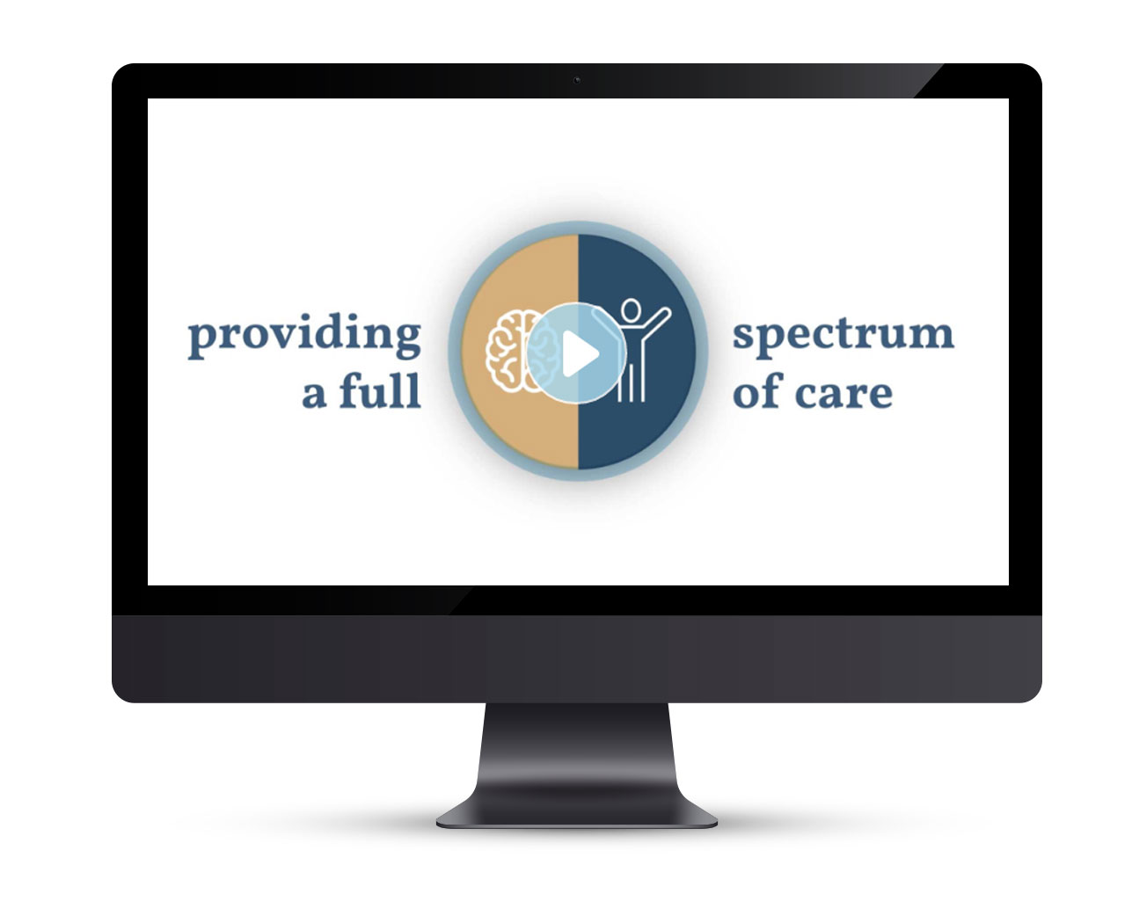
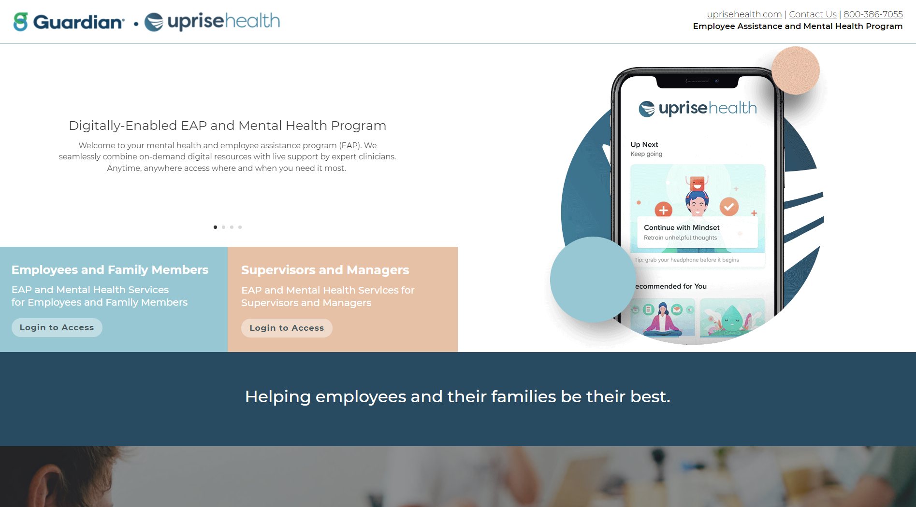
Login for Confidential Access
worklife.uprisehealth.com
Access Code: worklife
Notes:
Over our 20-year history, many access codes have been used. We have included those access codes to make sure your employees have access regardless.

Slide 5

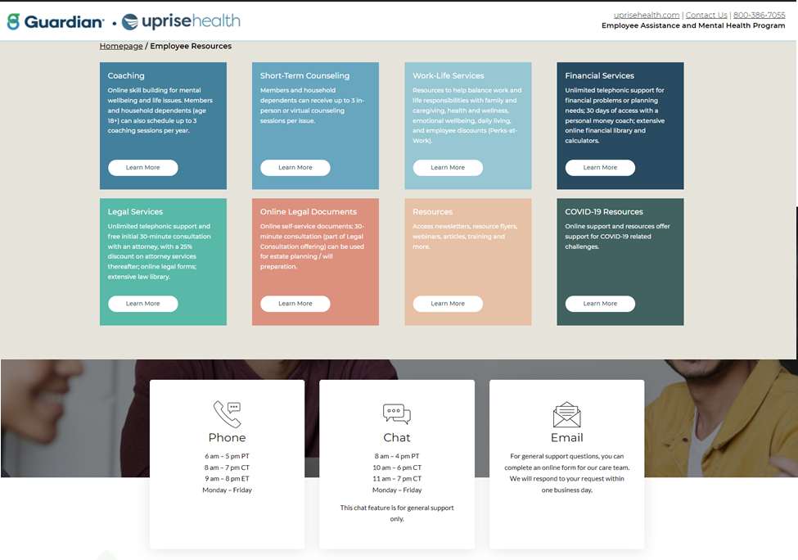
Online Access
Coaching
Counseling
Work-Life Services
Financial Services
Legal Services
Online Legal Documents
Newsletters and Training

Slide 6
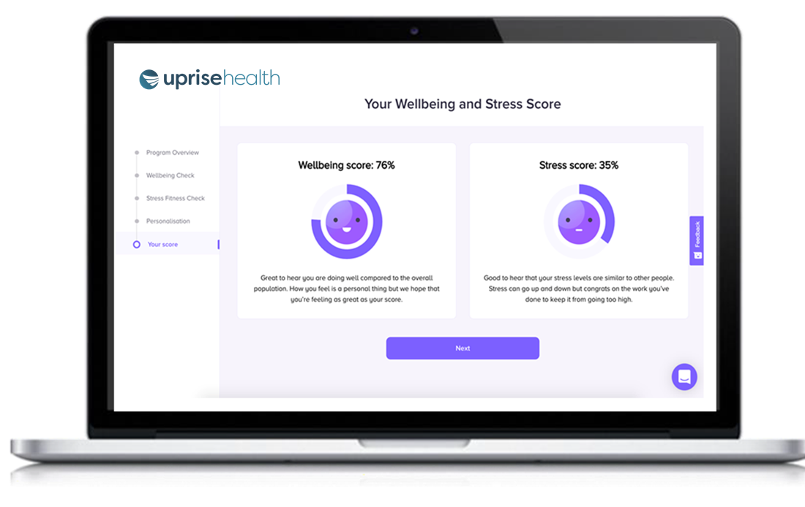
Online Courses and Coaching
Wellbeing Check
11 questions assess wellbeing
Less than 5 minute to complete
Online Courses
Access via the app or online
Videos and interactive exercises
Coaching
Self-guided CBT and skill building modules
Online scheduling with a coach
Notes:
When an employee or their family member is in need on on-demand support for a mental health issue, they can log into IBH's digitally enhanced EAP platform for immediate support. If this is the first time they have accessed our platform, the system will prompt them to take our clinically validated Wellbeing Check, an 11-question assessment that takes about 2 to 3 minutes to complete. The Wellbeing Check will determine the member's current mental fitness level and program needs. Using sophisticated and proprietary algorithms, the system will generate a score for the member's wellbeing and stress level and will then recommend a list of programs and services that are specifically titrated to the member's needs.
Recommended services could include:
• A list of curated cognitive behavioral therapy (CBT)-based exercises that target the major areas of need identified by the Wellbeing Check and a prompt to engage in the first recommended module
• The option to connect with a Coach via chat for additional support immediately or via a scheduled 30-minute telephonic, video or chat session
• The option to connect with a local network provider for counseling via face-to-face, telephonic or video sessions, based on the members' preference
• A prompt to connect with the EAP, 911 or the National Suicide Prevention Hotline if the individual is in crisis
If the member chooses to engage in the first exercise of their curated CBT-based curriculum, they can immediately start the module, most of which take between 3 and 13 minutes to complete. If the member believes they would benefit from talking to a professional who will listen to their concerns and provide focused recommendations, our platform will offer the option to speak with a coach or local network counselor. Members will be able to self-select the coach or counselor that best matches their need, availability, and preferences (e.g., female counselor that has availability and specializes in LGBTQ issues and working with people of color). They will also be able to continue partaking in their curated CBT curriculum, which will help them develop skills to address and alleviate some of the immediate stress they may be feeling. They may also continue to engage in coaching to build resilience during highly stressful times.

Slide 7
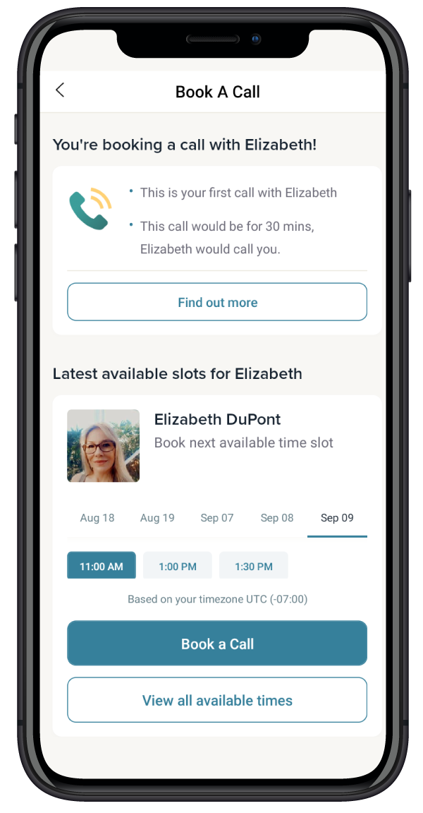
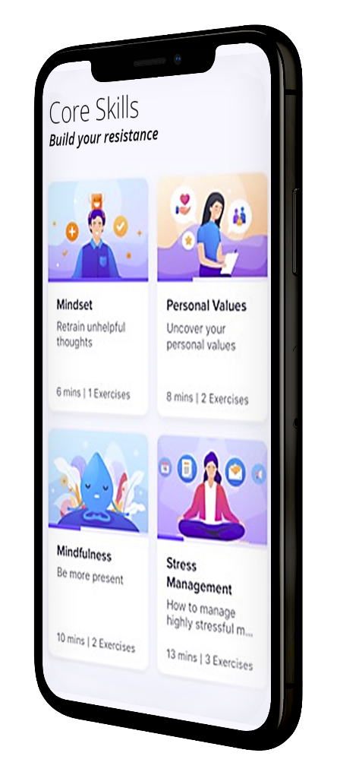
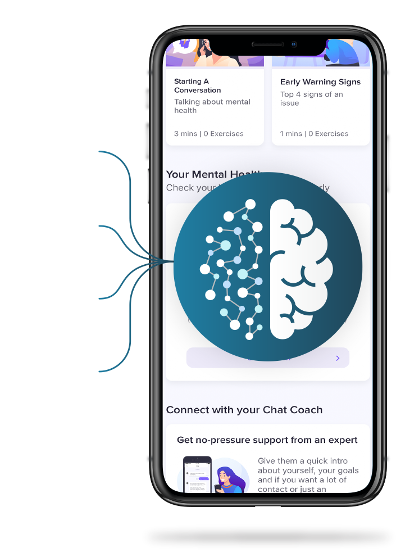
Scheduling a Coach
All coaching is accessed and booked online
Employees choose their level of support
Options for chat or phone-based coaching
Eligible for up to 3 coaching sessions

Slide 8
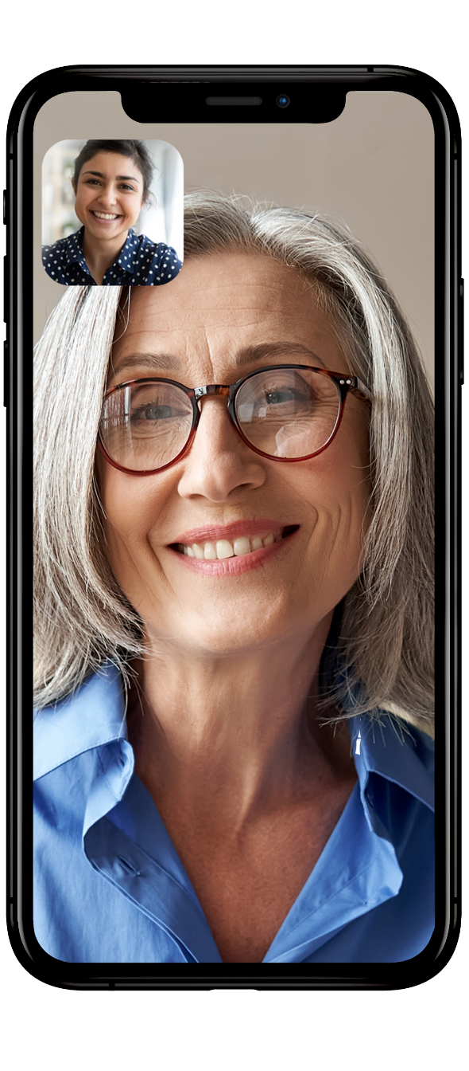
Short Term Counseling
Convenient, secure access to short-term counseling
Phone, video and face to face sessions
Member will be asked about their needs to be matched with a counselor
Eligible for up to 3 counseling sessions per issue for each member of the household, including employee, spouse and unmarried dependents up to age 26
Member can schedule their own appointment, or we can help with scheduling

Slide 9
How the Counseling Works
800.386.7055
ibhworklife.com
User ID: matters PW: wlm70101
Up to Three (3) No-Cost EAP Visits Per Incident
Toll free telephonic intake and benefit consultation service
Triage and problem assessment
Referral to counselor or behavioral health professional
For all employees and dependents
Referral to Medical or Behavioral Health Plan if condition is long term
What to Expect When You Call to Request Counseling
You will speak directly with an Uprise Health representative
You will be asked about your needs to be matched with a counselor
You can schedule your own appointment, or we can help with scheduling
If you are in crisis, your call will be connected for immediate help

Slide 10
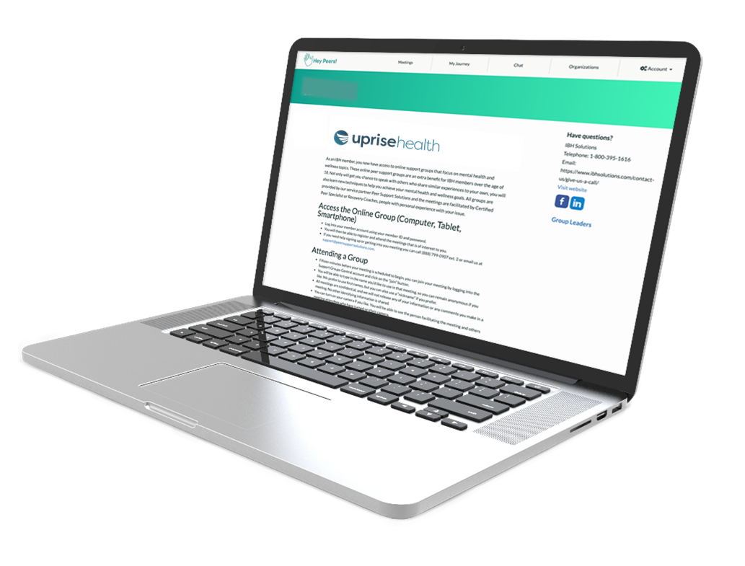
Online Peer Support Groups
Employees can join online support groups with others who have similar issues to share ideas, support, and encouragement. All employees and dependents are eligible for 10 peer support group sessions.
Offering a wide variety of groups, which are confidential and led by certified peer specialists or recovery coaches:
Addiction Recovery
Anxiety
Depression
Front Line Employees/First Responders
Grief and Loss
Parenting
Notes:
Most of your employees will be able to get assistance from our new digitally enhanced program

Slide 11

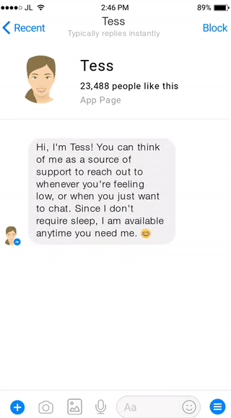
Emotional Support & Check Ins
24/7 chatbot for emotional support and check-ins to boost wellness.
Helps build resilience and self awareness by practicing coping skills.
Reminders and check-ins helps reinforce skills learned.
The more chats with Tess, the more she will learn needs and preferences.
Say “Hi” to Tess and enter WorkLifeMatters
Text: 650-825-9634

Slide 12
Work-Life Resources
Support for work-life issues that impact a members' ability to stay present and productive at work, including:
Legal Services
Financial Services
Online Legal Forms
Child and Parenting Resources
Adult and Elder Care Services
Training and Webinars
Notes:
In addition, our coaching and counseling services address all areas of stress, anxiety, depression, grief and other mental health issues, except those that require longer-term or more specialized care. Finally, our work-life services address those issues that may provide barriers on the member's path to wellbeing, including personal and family challenges, as well as legal and financial issues. By offering holistic services that address emotional, work-life, physical, and social health, we address the full continuum of care and provide support for everyone from the lowest-risk, often online-only user to the highest-risk individual who is in need of immediate clinical support.

Slide 13
Connect with Your EAP
800.386.7055
worklife.uprisehealth.com
Access Code: worklife

